Slide 1

5-5 NAT
The distribution of addresses through ISPs has created a new problem. If the business grows or the household needs a larger range, the ISP may not be able to grant the demand because the addresses before and after the range may have already been allocated to other networks. In most situations, however, only a portion of computers in a small network need access to the Internet simultaneously. A technology that can help in this cases is network address translation (NAT).

Slide 2
Topics Discussed in the Section
Address Translation
Translation Table

Slide 3
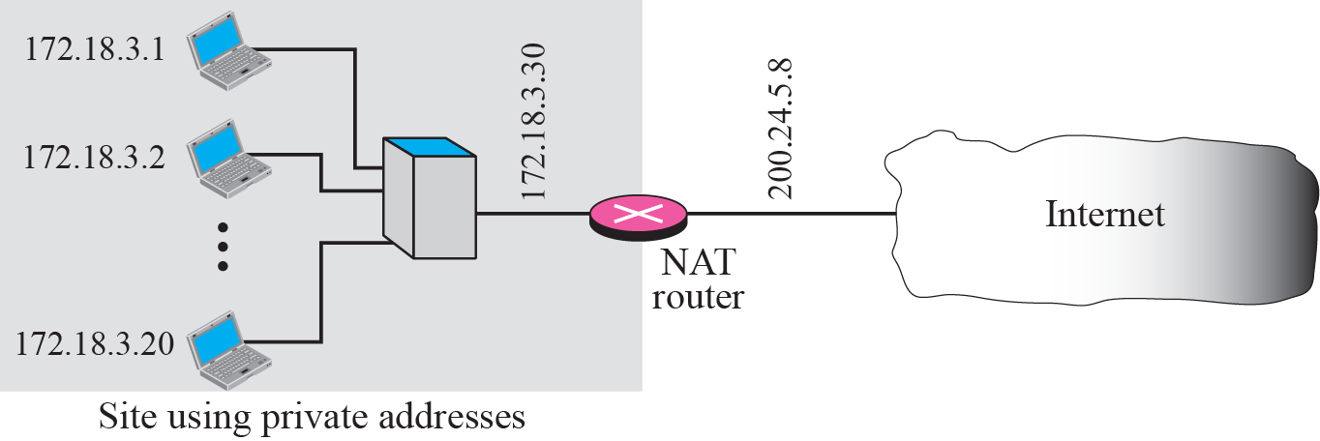
Figure 5.39 NAT

Slide 4
Figure 5.40 Address resolution

Slide 5
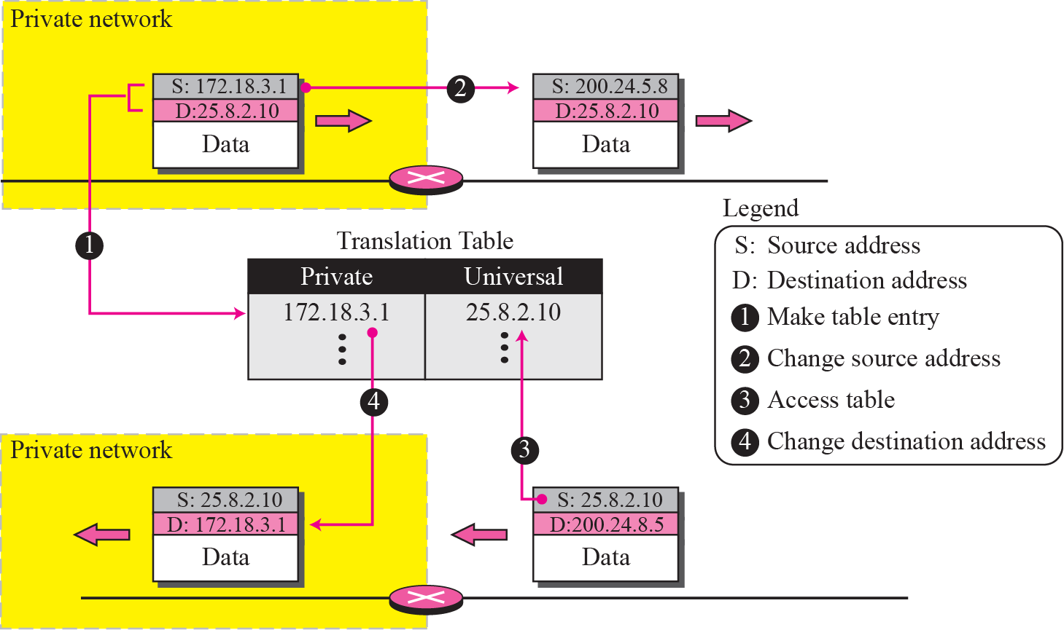
Figure 5.41 Translation

Slide 6
NAT Table with only IP addresses (3)
If using only one global address
Only one private-network host to access the same external host
If using a pool of global addresses (e.g. 4 addr)
No more than 4 connections can be made to the same destination
No private-network host can access two external server programs (e.g. HTTP and TELNET) at the same external host at the same time ???
Two private-network hosts cannot access the same external server program at the same time (by using the same global address)

Slide 7
NAT Table with IP address & Port # (1)
Same external host
(Telnet)
1 global address
NAT Table for G1
P1:#1→D1:#23
P1:#1
G1:#1
G1:#1→D1:#23
P1:#2→D1:#23
P1:#2
G1:#2
G1:#2→D1:#23
3 privates
P2:#1→D1:#23
P2:#1
G1:#3
G1:#3→D1:#23
P3:#1→D1:#23
P3:#1
G1:#4
G1:#4→D1:#23
Must be unique
D1:#23→P1:#1
D1:#23→G1:#1
D1:#23→P1:#2
D1:#23→G1:#2
D1
D1:#23→P2:#1
D1:#23→G1:#3
D1:#23→P3:#1
D1:#23→G1:#4

Slide 8
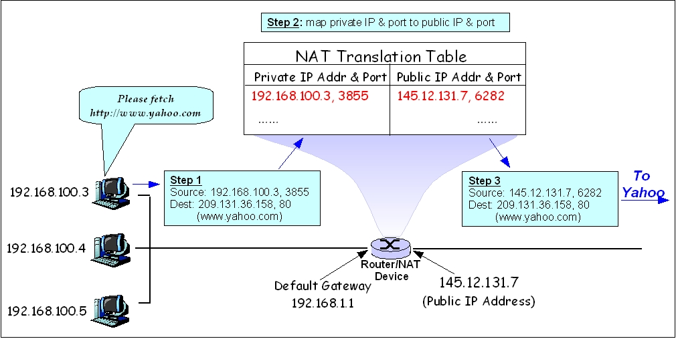
NAT Table with IP address & Port # (2)
Must be unique

Slide 9
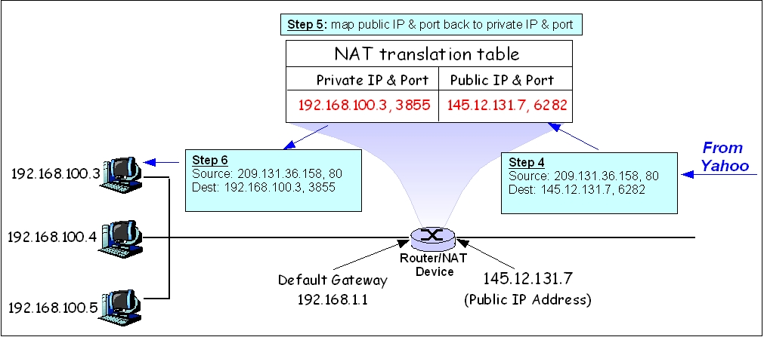
NAT Table with IP address & Port # (3)

Slide 10
NAT Table with IP address & Port # (4)
NAT Table in the textbook
This may not be the best way to understand NAT
Server
Must be unique
Otherwise reassign a new private port and cache the mapping (the new port --> the old port)

